Slide 1
How to work with Visual Studio
And be more productive

Slide 2
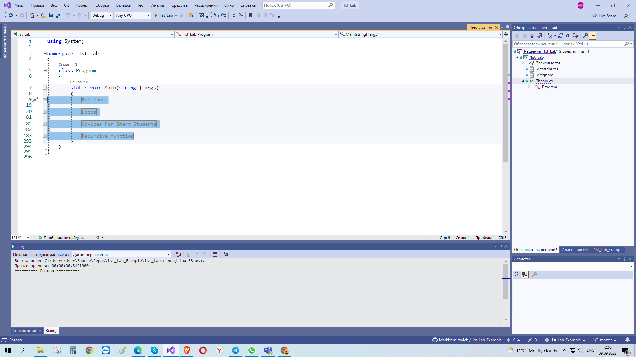
After you copied file from GitHub delete all in the Main method
You can add extensions here (using search)

Slide 3
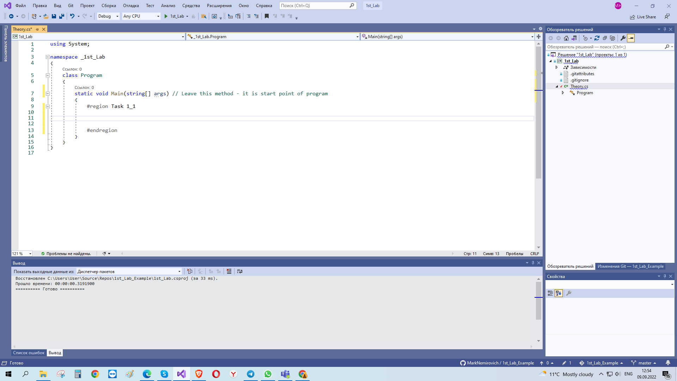
If you create new project, check, is there lines 1-7 as below (library, namespace, class & initial method). Create them otherwise.

Slide 4
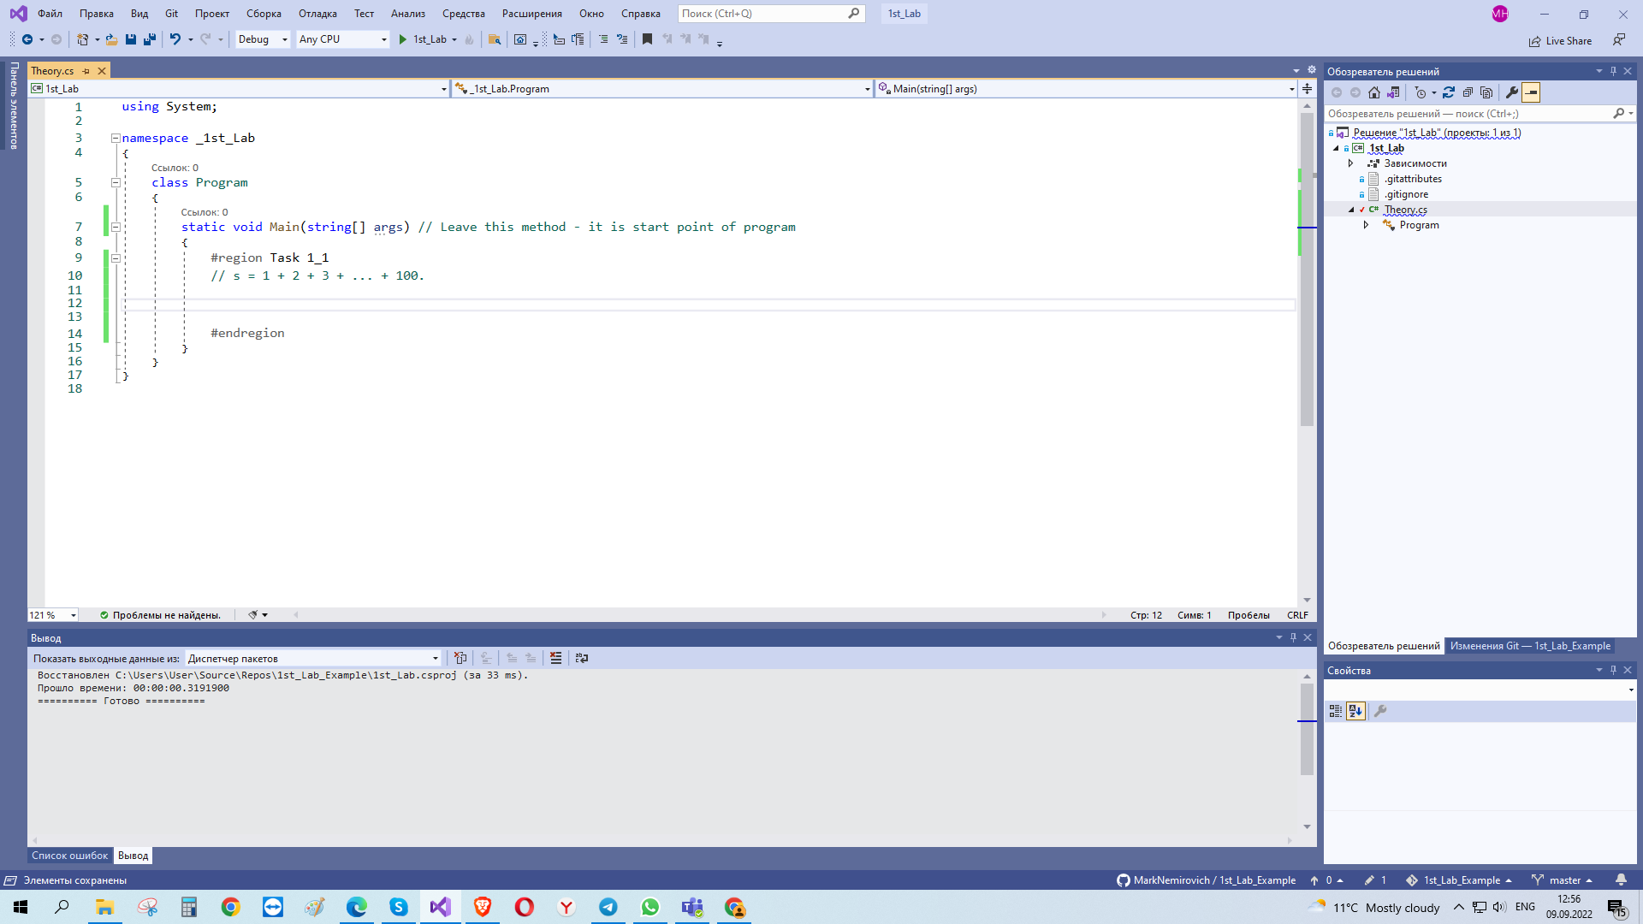
Add space for your 1st task with #region block and add comment with task

Slide 5
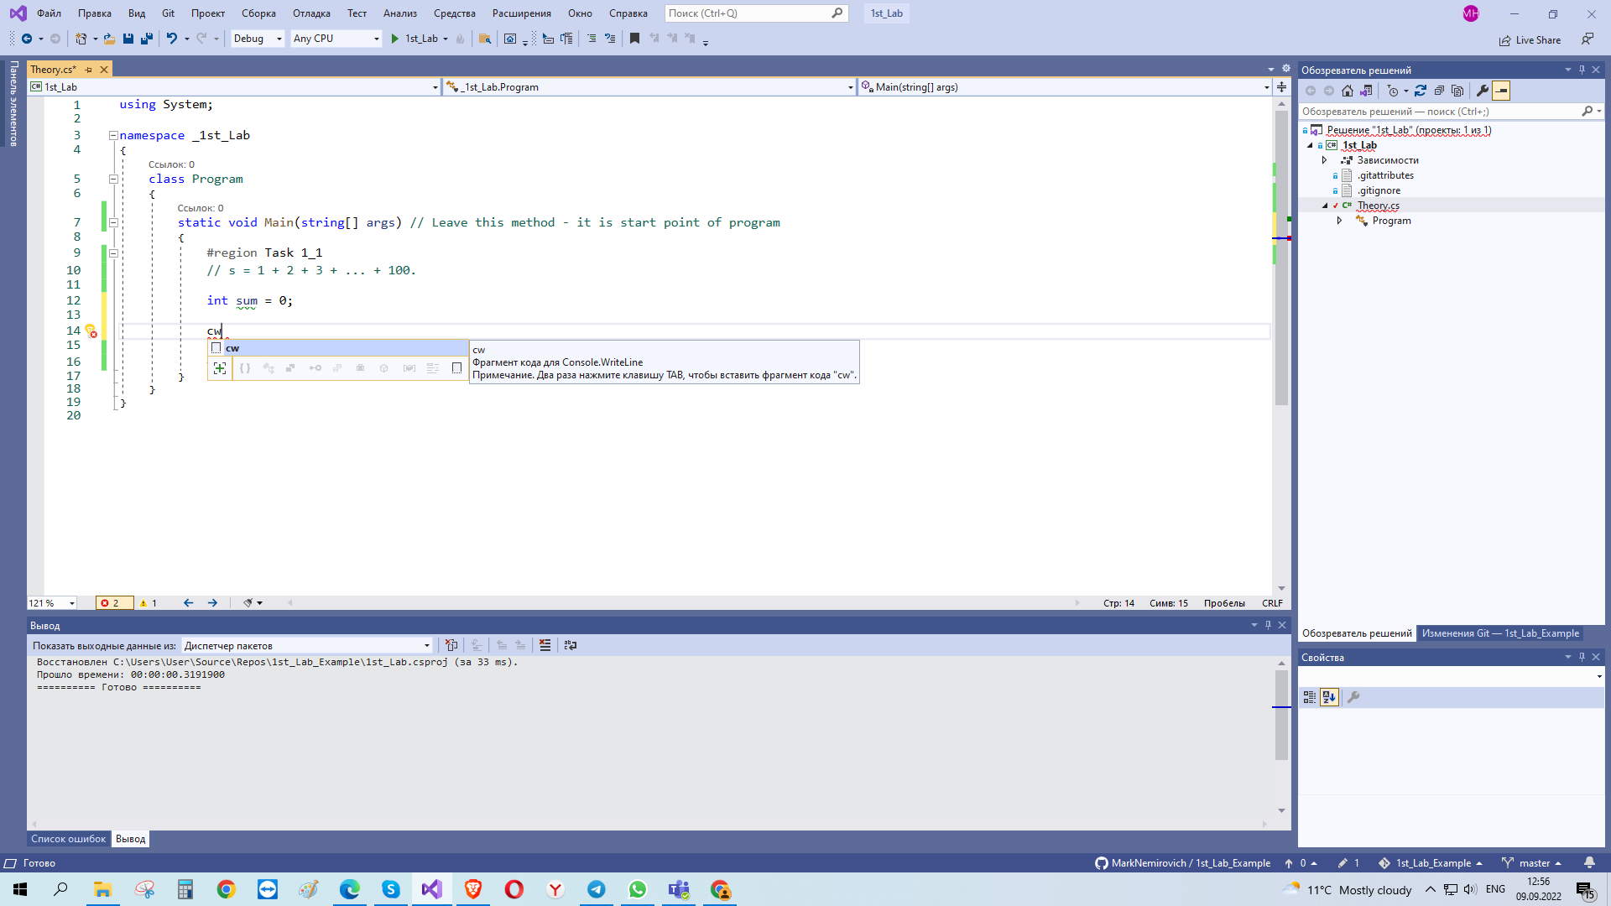
For output you can use shortcut

Slide 6
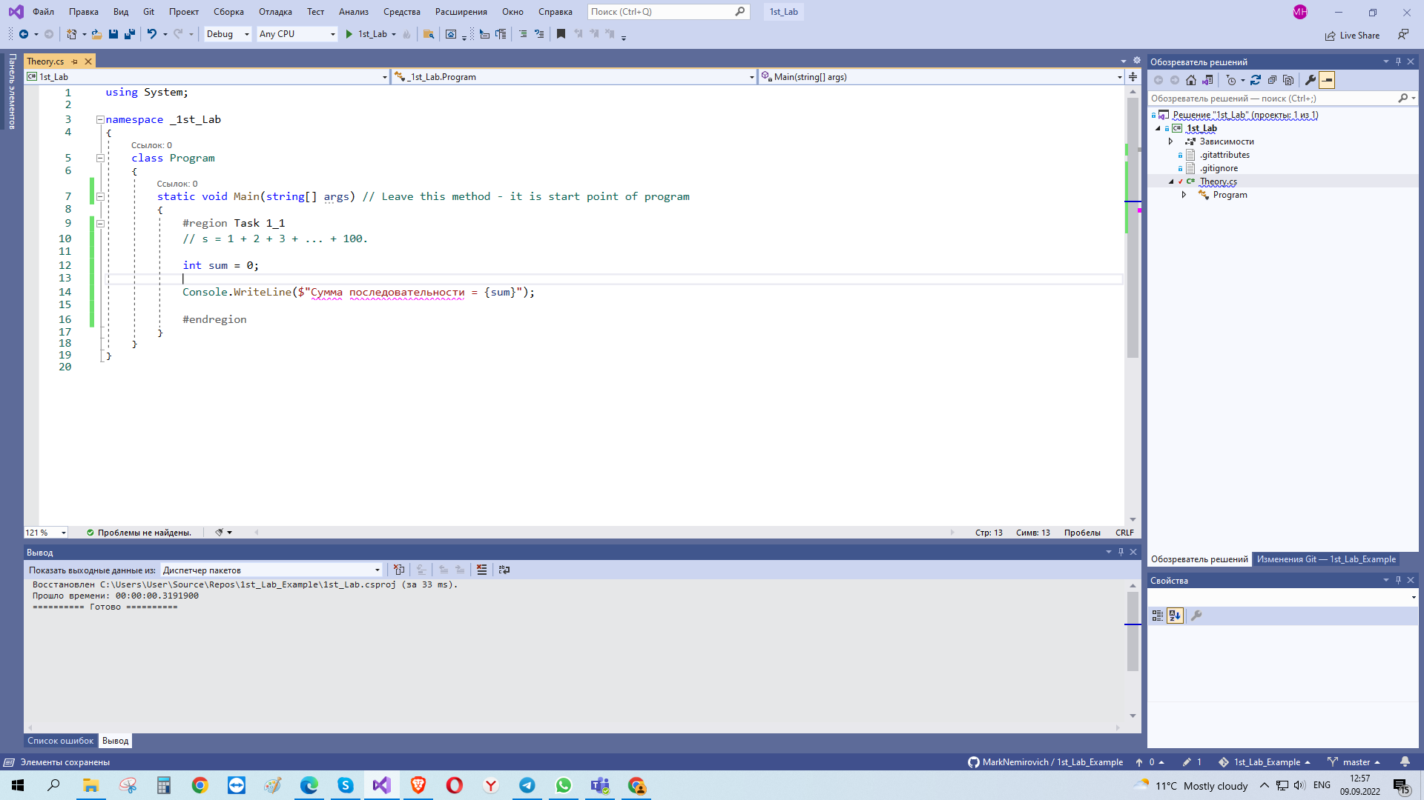
Firstly, add all variables you want to use and add in output the answer

Slide 7
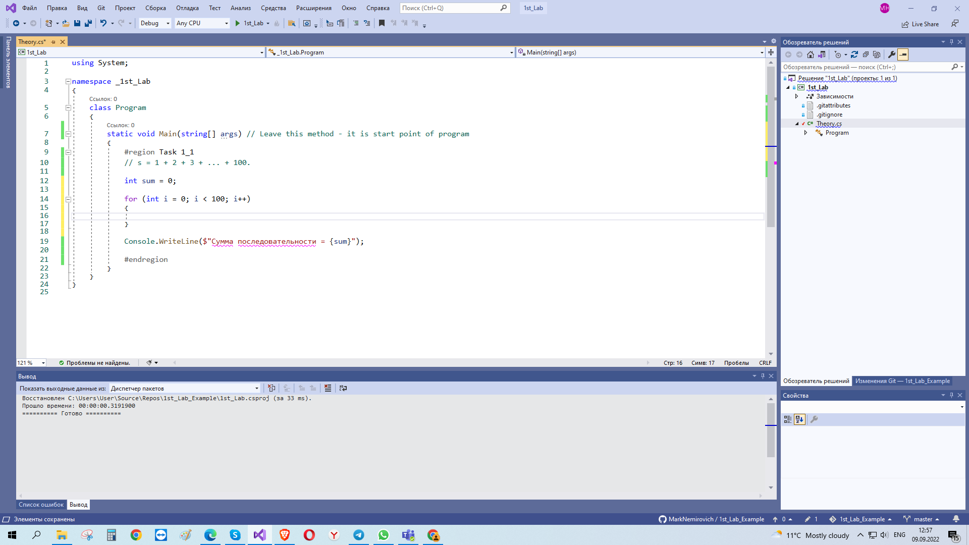
Thet think about algorithm you will use to solve the task and create it from general constructions to detail’s realization

Slide 8
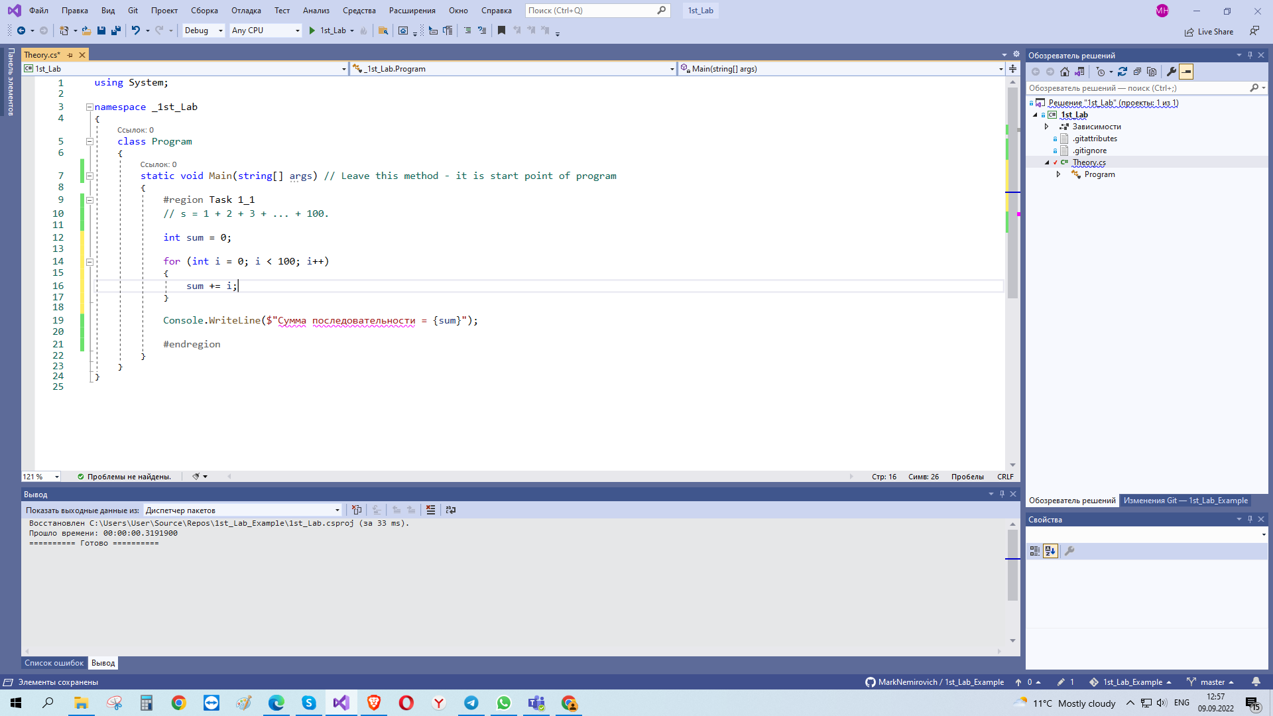
After you finish some part of work press CTRL+S to save project

Slide 9
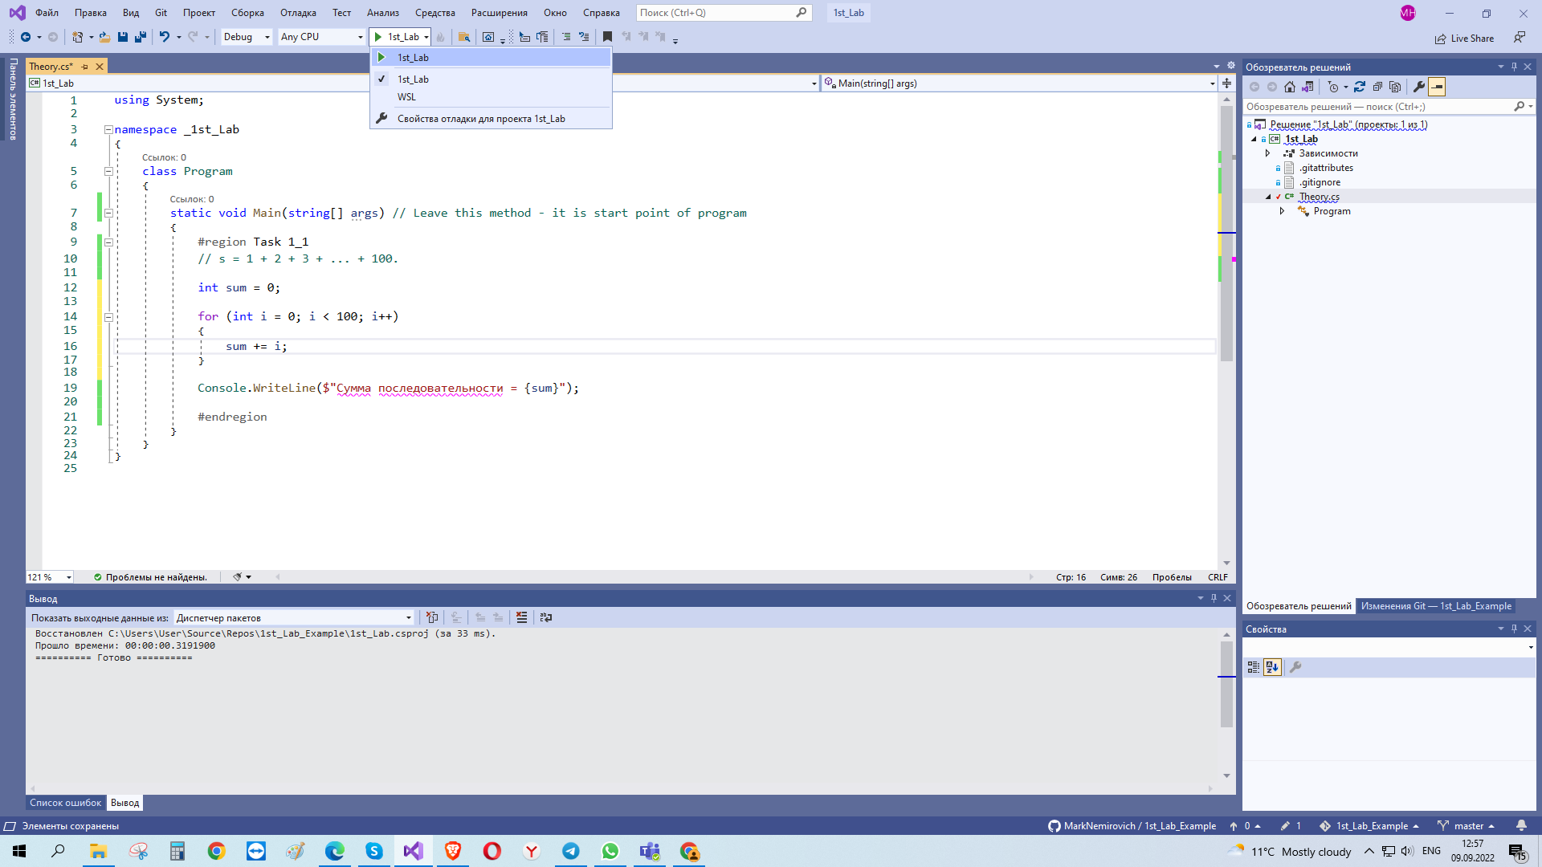
Then start the execution

Slide 10
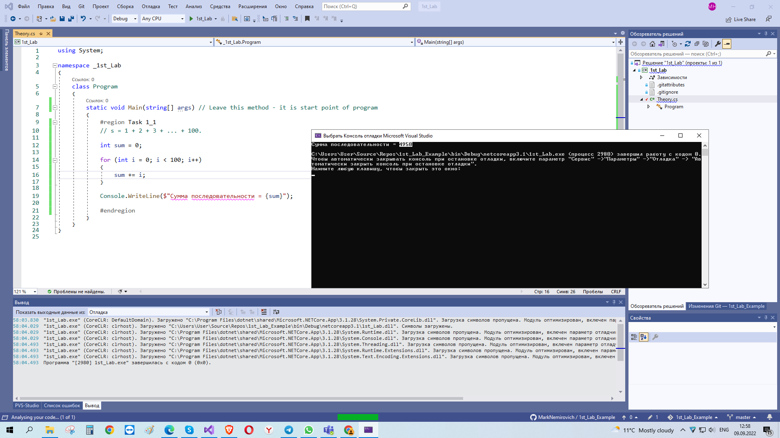
If you see that answer different from you expected, check your program from general constructions to detail’s realization

Slide 11
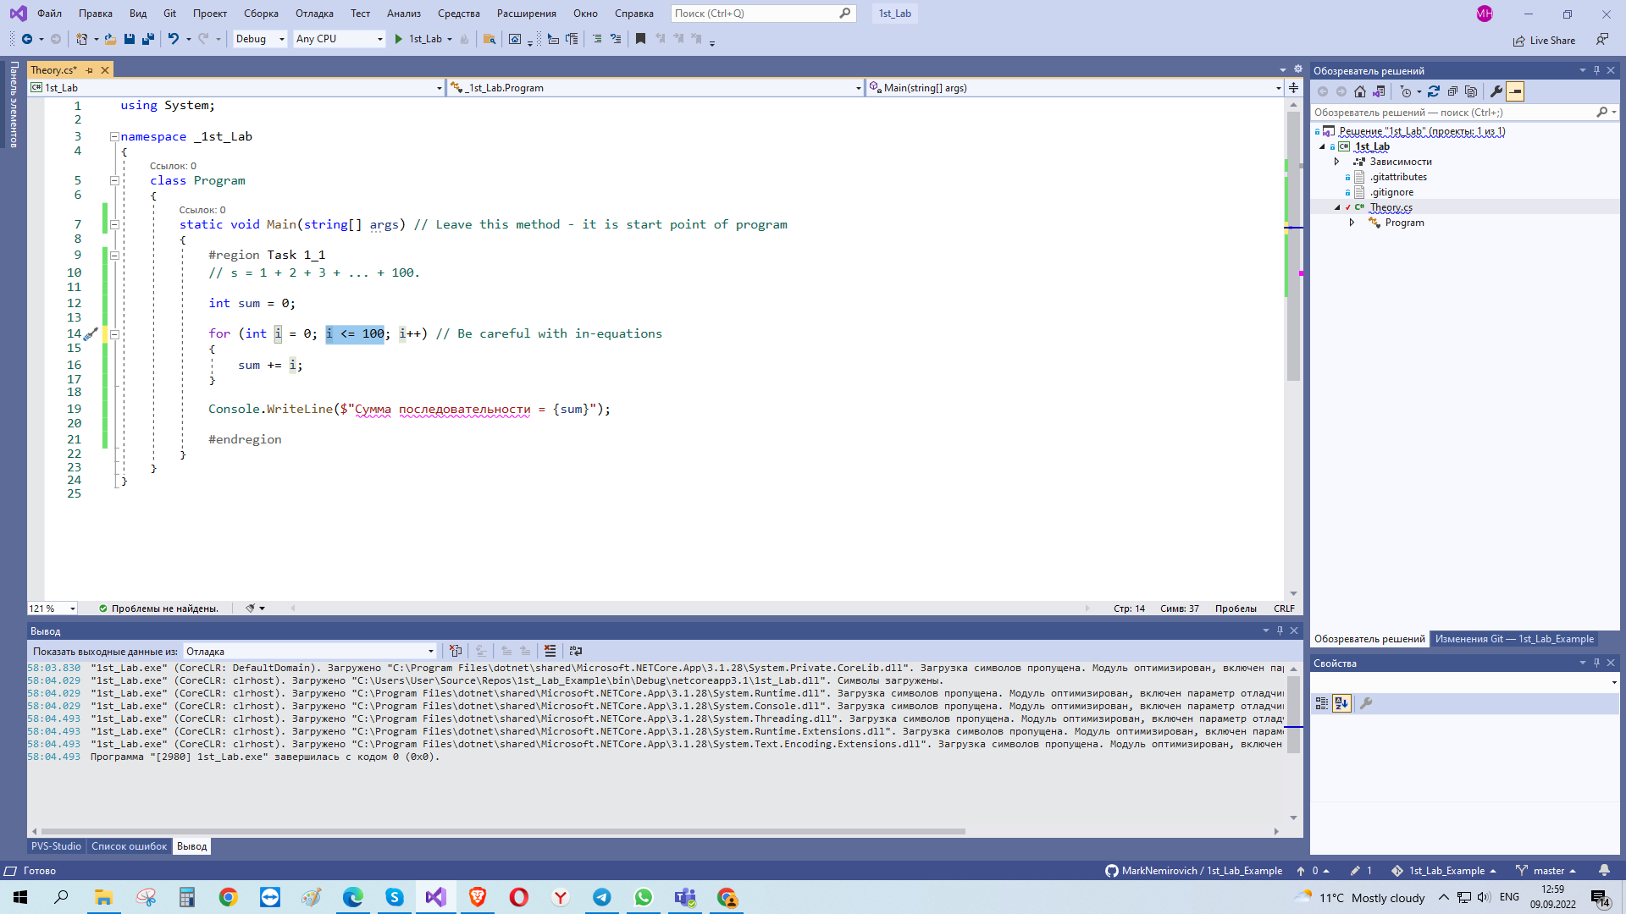
There is difference between < and <= Such little mistake can make you mad

Slide 12
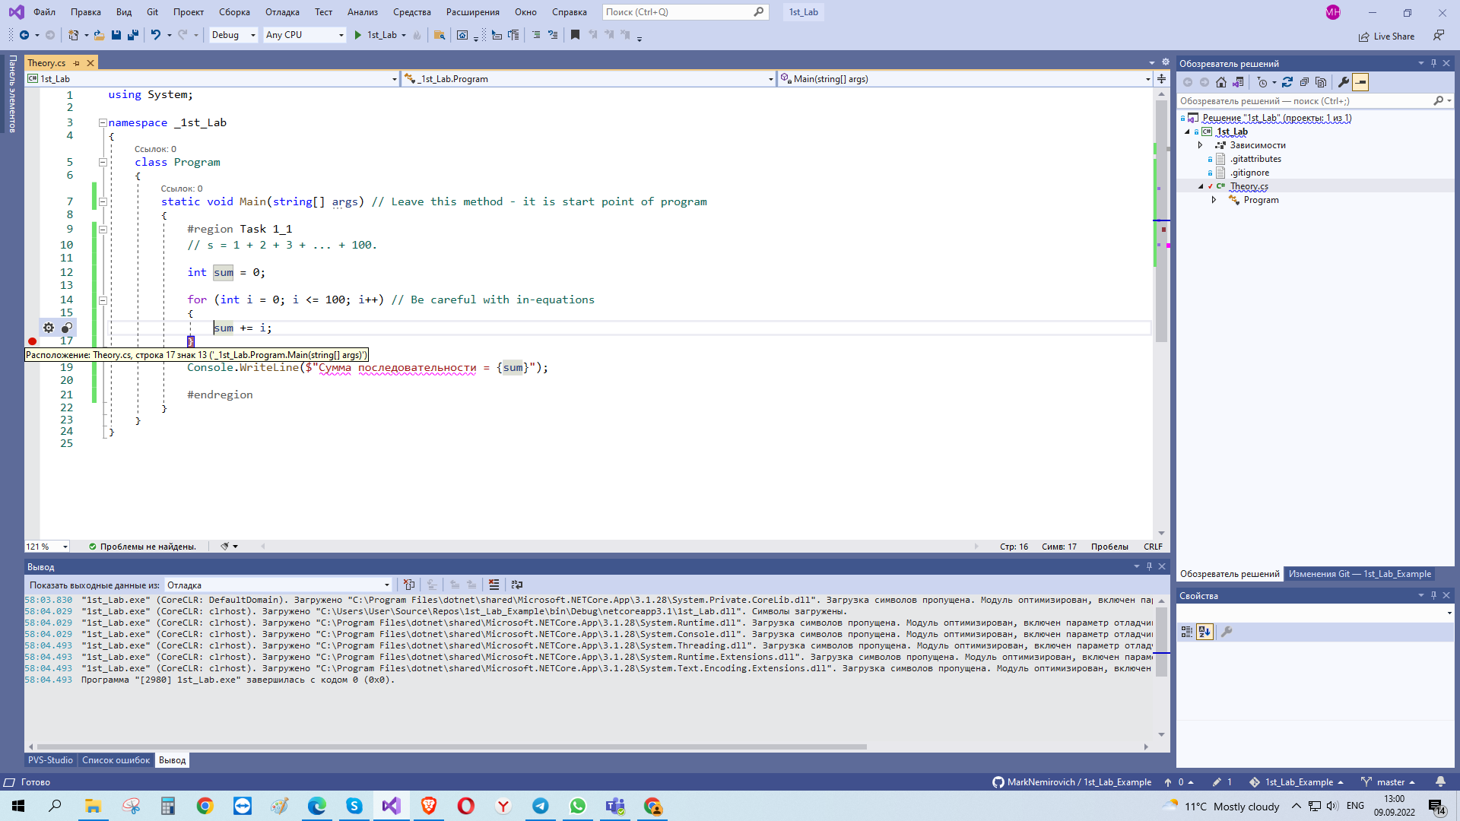
It is stop point for debugging. Very important thing that can help you to seek mistakes!!!

Slide 13
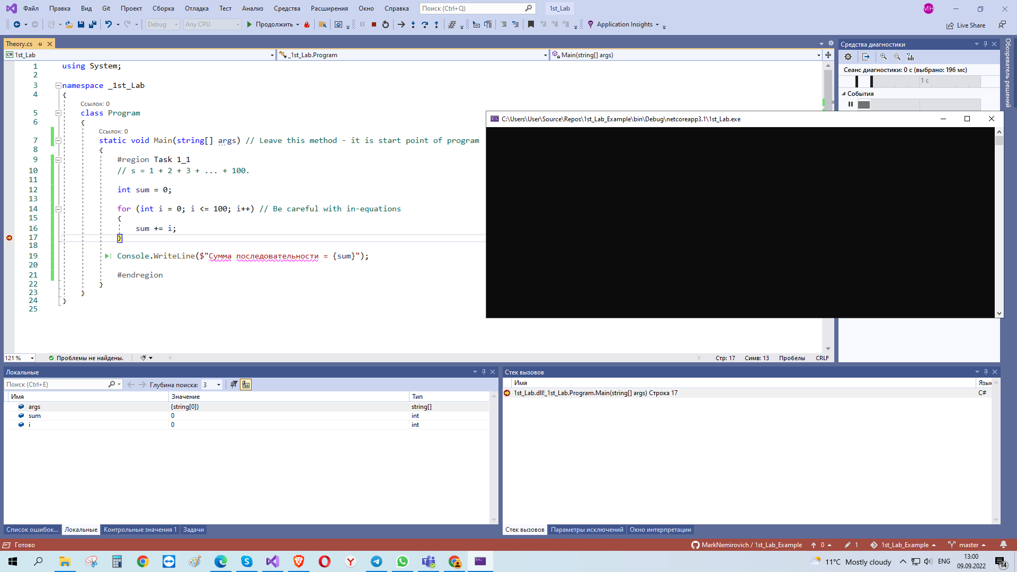
When you launch your project, it will stop at the line you marked and in the “local” you will see all existing at that moment variables

Slide 14
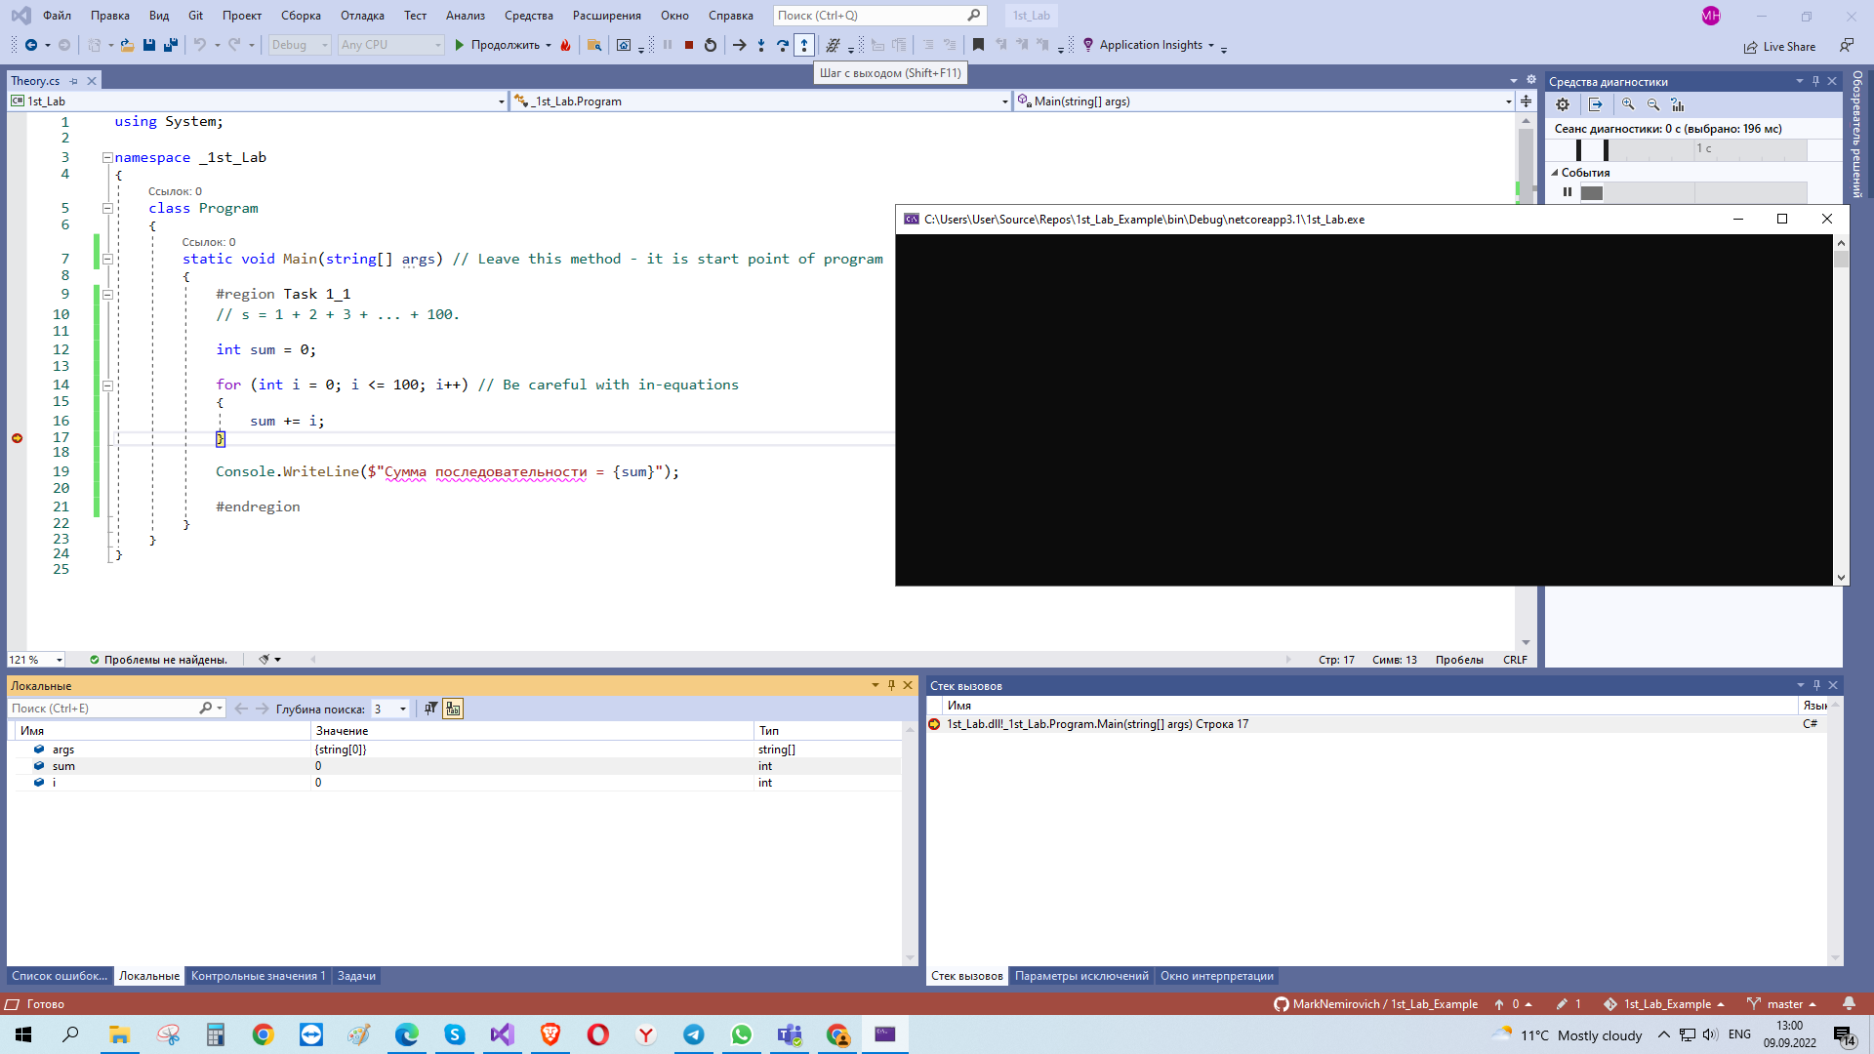
You can jump from one to another mark (or on the one in the cycle) with 3 types: jumping to internal methods (lab_5), go ahead in this method or go to external point of entrance

Slide 15
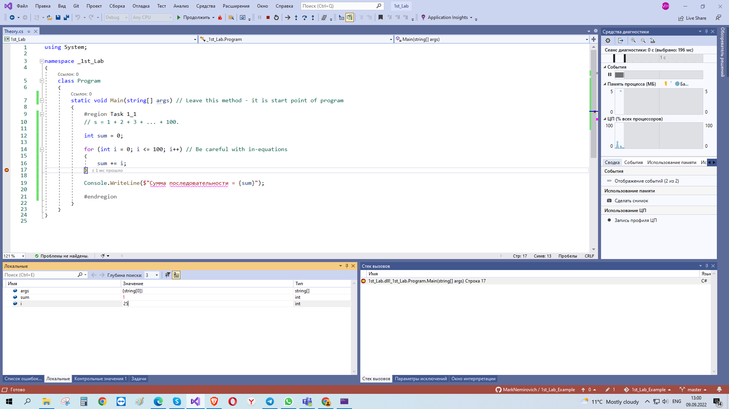
You can change variables as you wish while execution at the pause

Slide 16
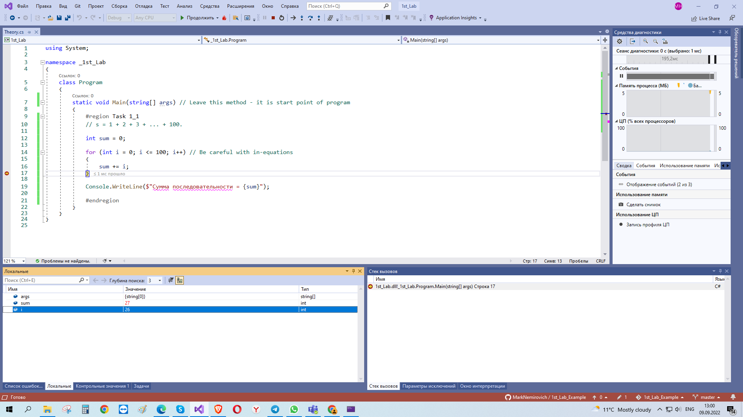
After continue, program will use variables you changed (so I will test your programs for fault-tolerance

Slide 17
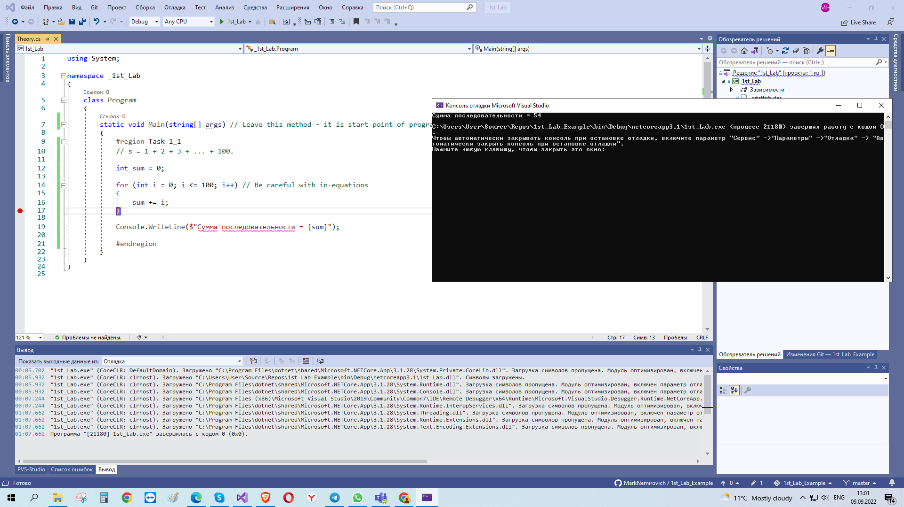
Use it in that places where program breaks. But! If you choose line with calculations, program will stop before making them

Slide 18
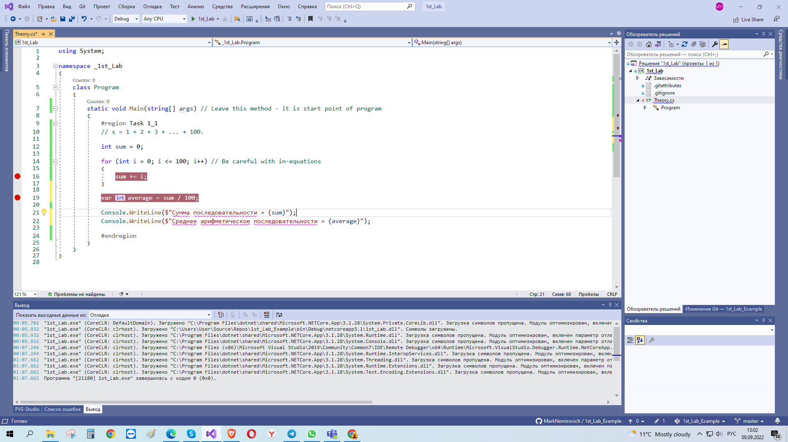
You can add / remove marks even when program at pause (not only before start)

Slide 19
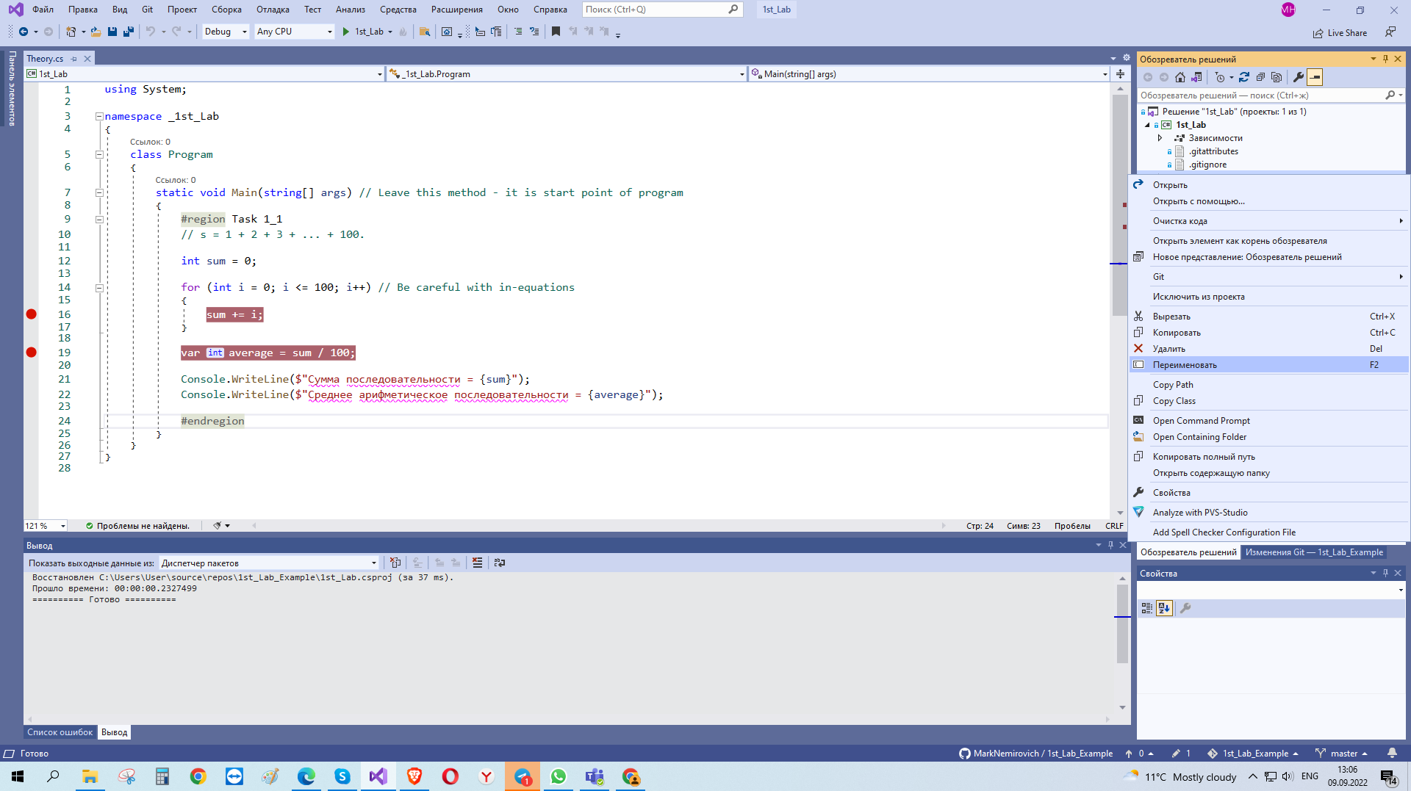
You can rename your project

Slide 20
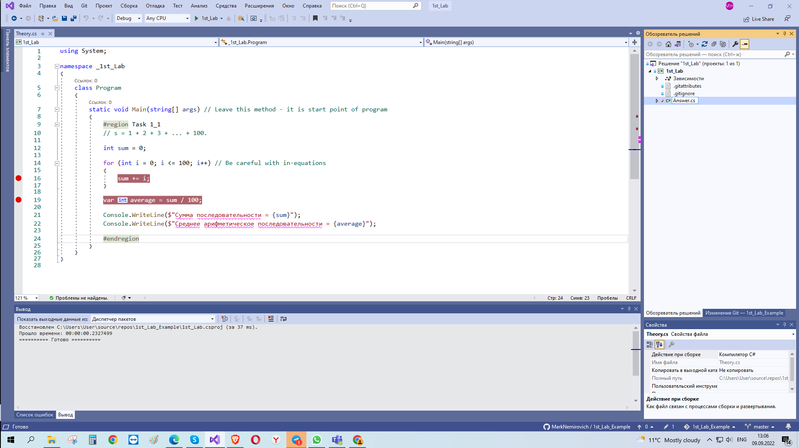
Or even folder (above)

Slide 21
1st method to upload work to GitHub
From VisualStudio

Slide 22
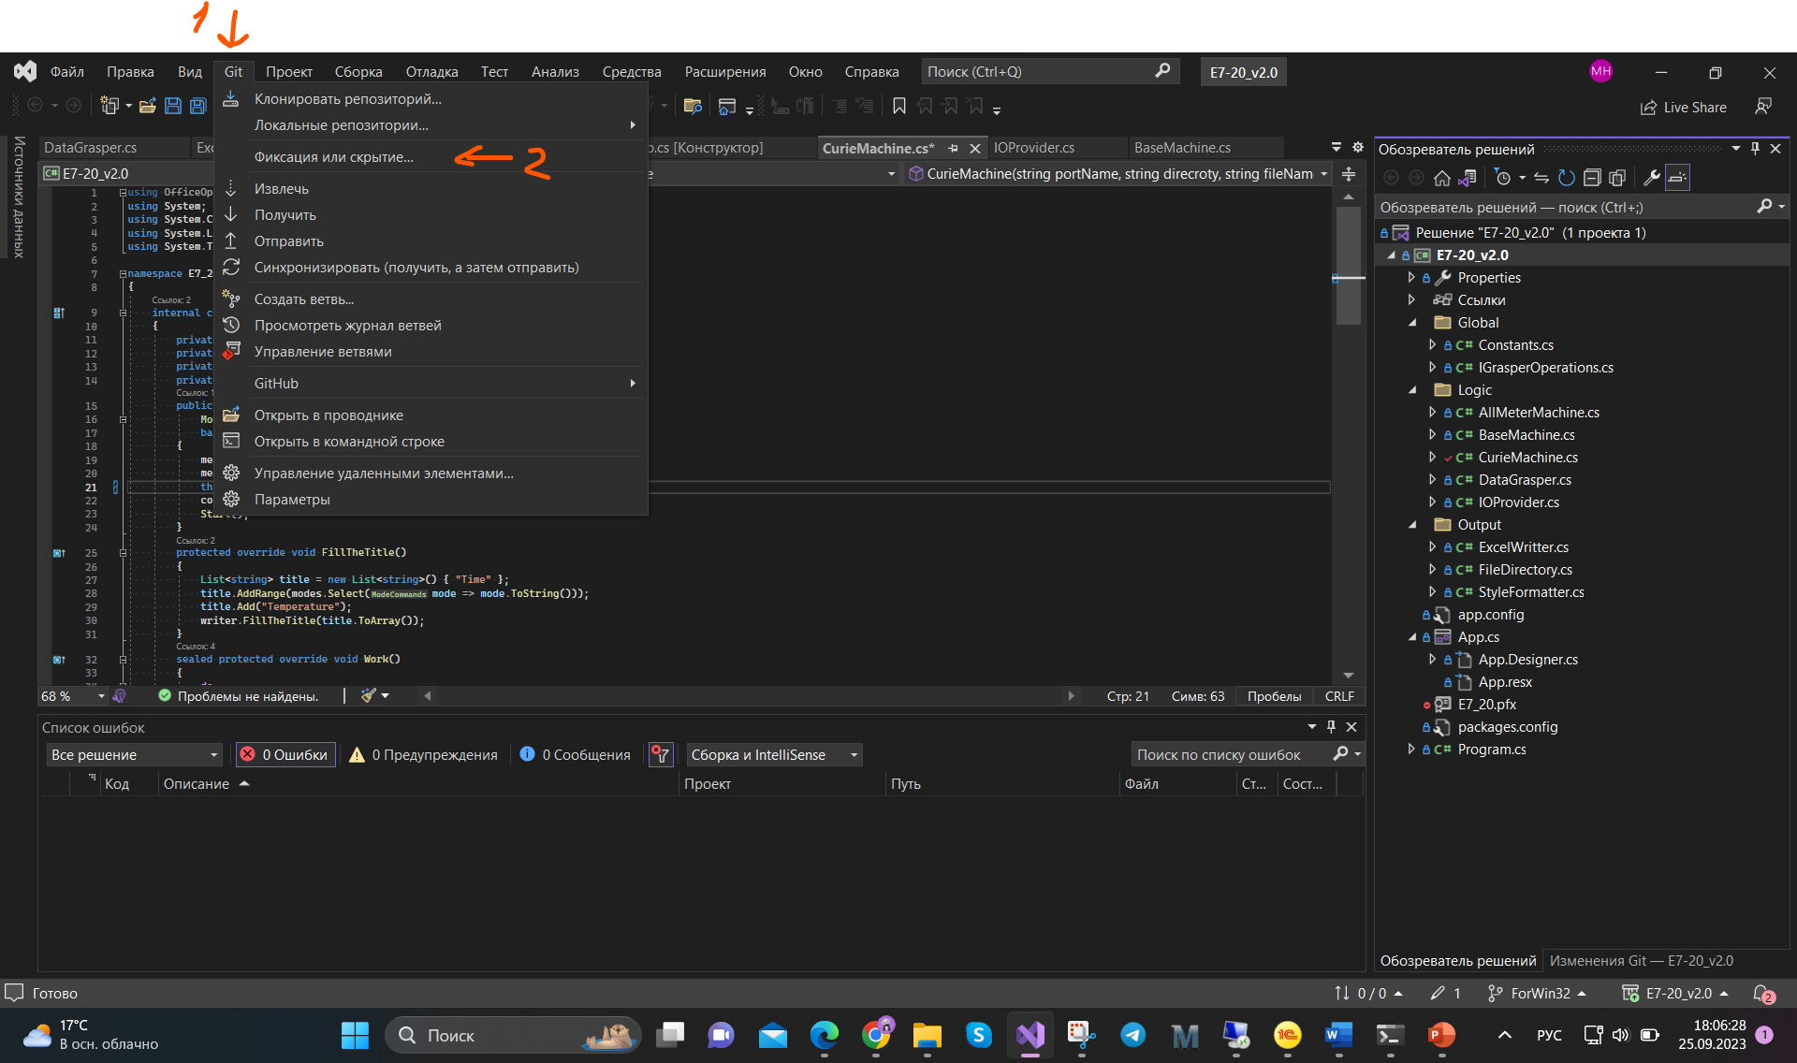
Go to the Git integrations tab

Slide 23
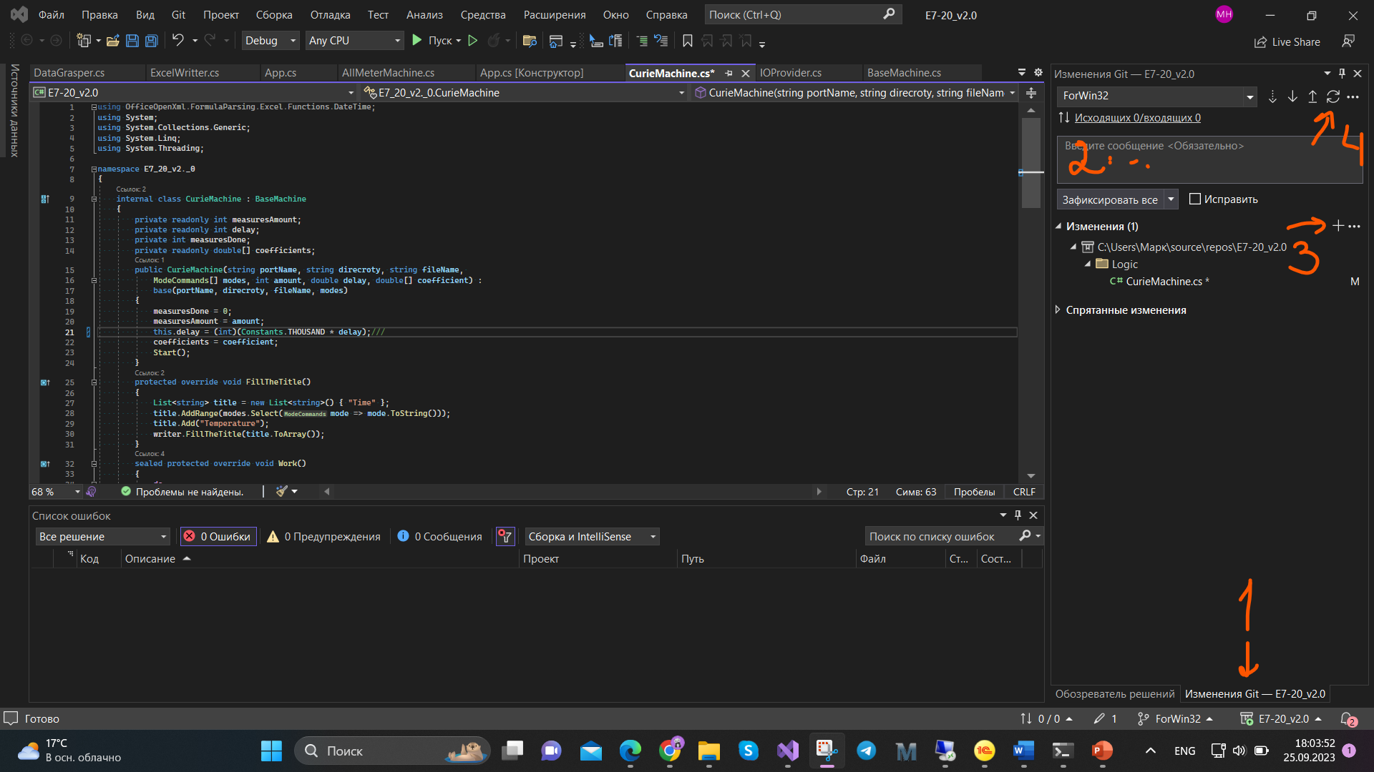
If you're already connected to Git, add any changes, describe what you did, and sync the branch

Slide 24
I advise you to do synchronization after each issue, so that if something happens... you already have the last save on the server

Slide 25
2nd method to upload work to GitHub
Also, you can do it using bash commands, but it is for advanced users

Slide 26
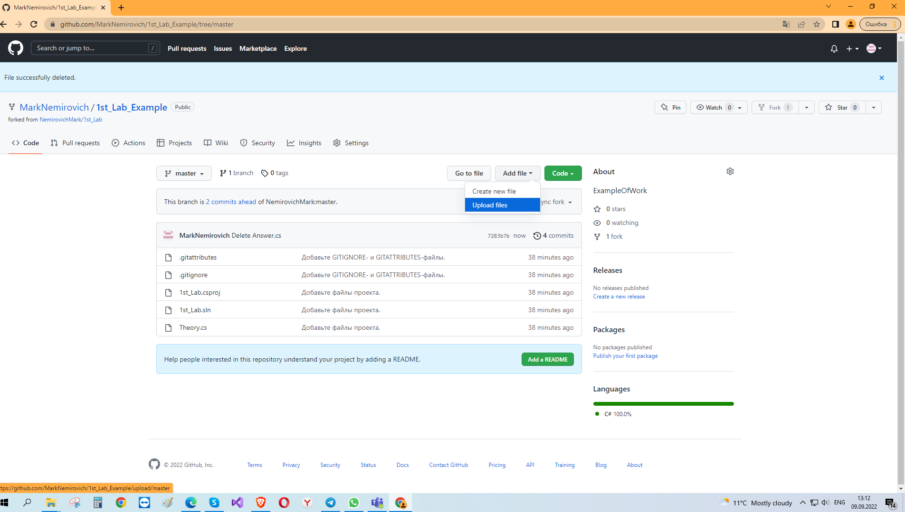
Well. Go then to your GitHub and add file (upload)

Slide 27
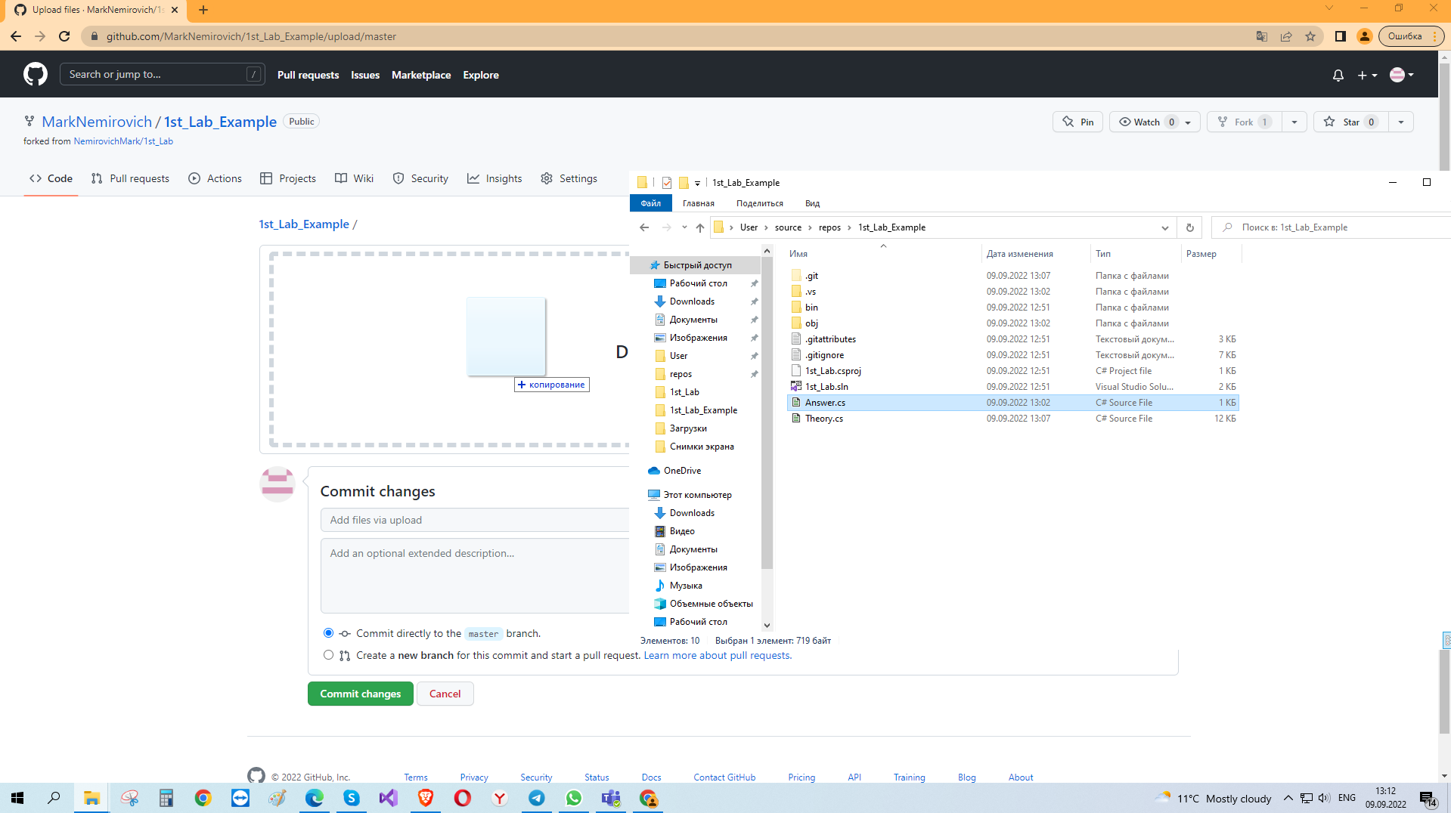
Drug from your PC .cs file

Slide 28
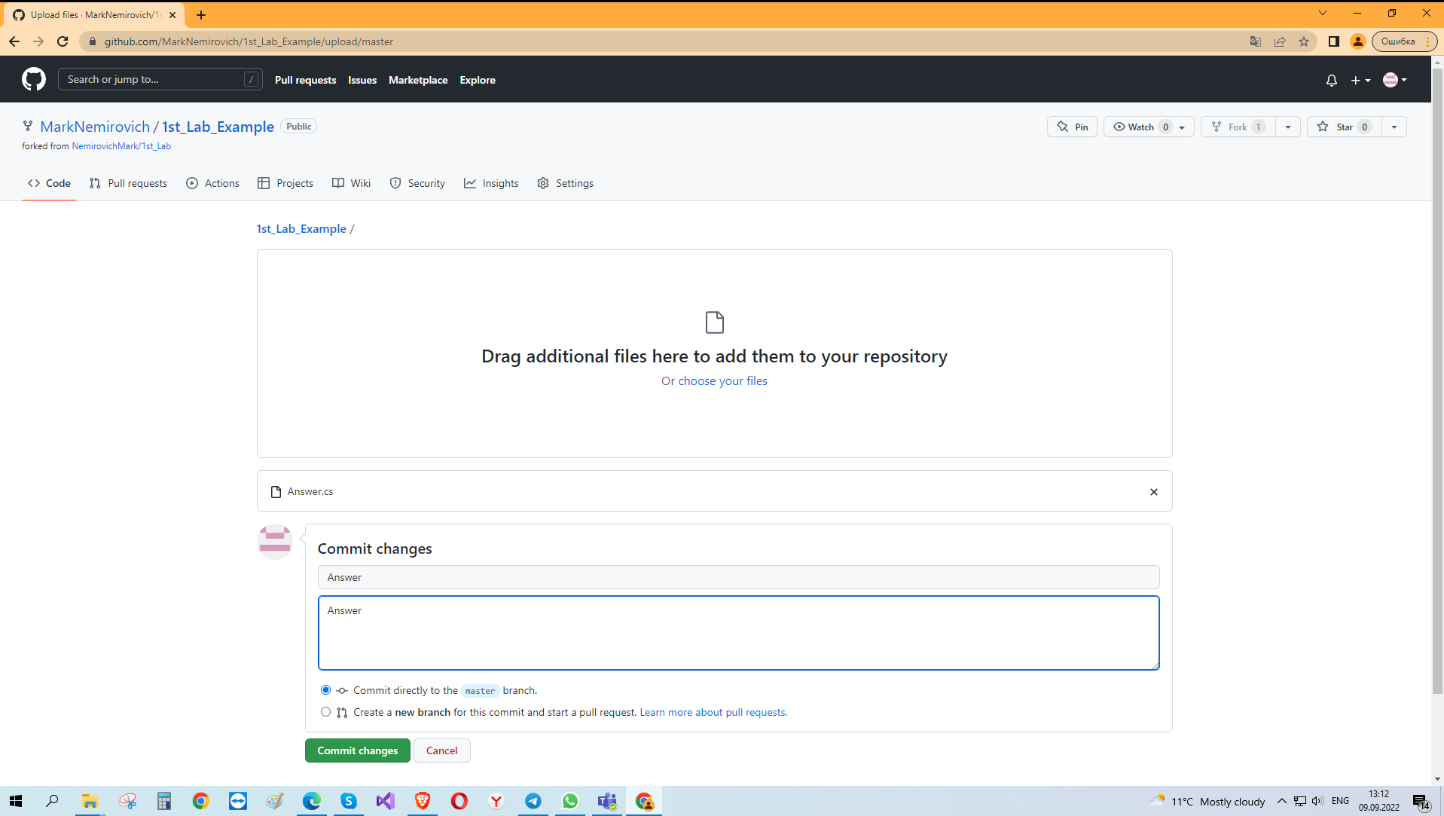
Add any comment, just for you

Slide 29
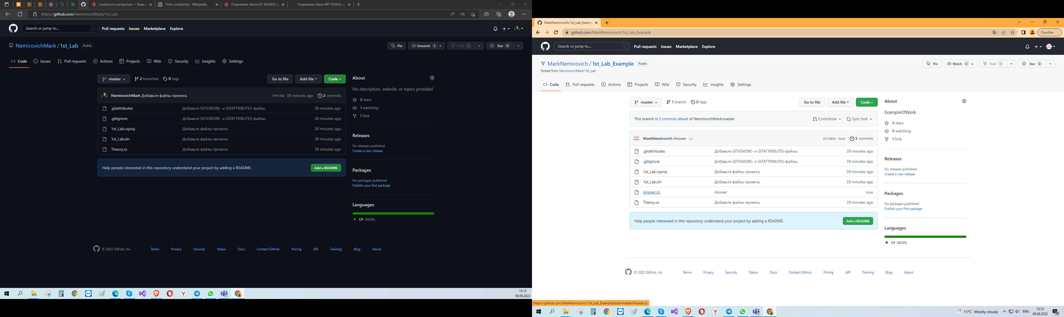
You have this file in your repository, but I don’t see it

Slide 30
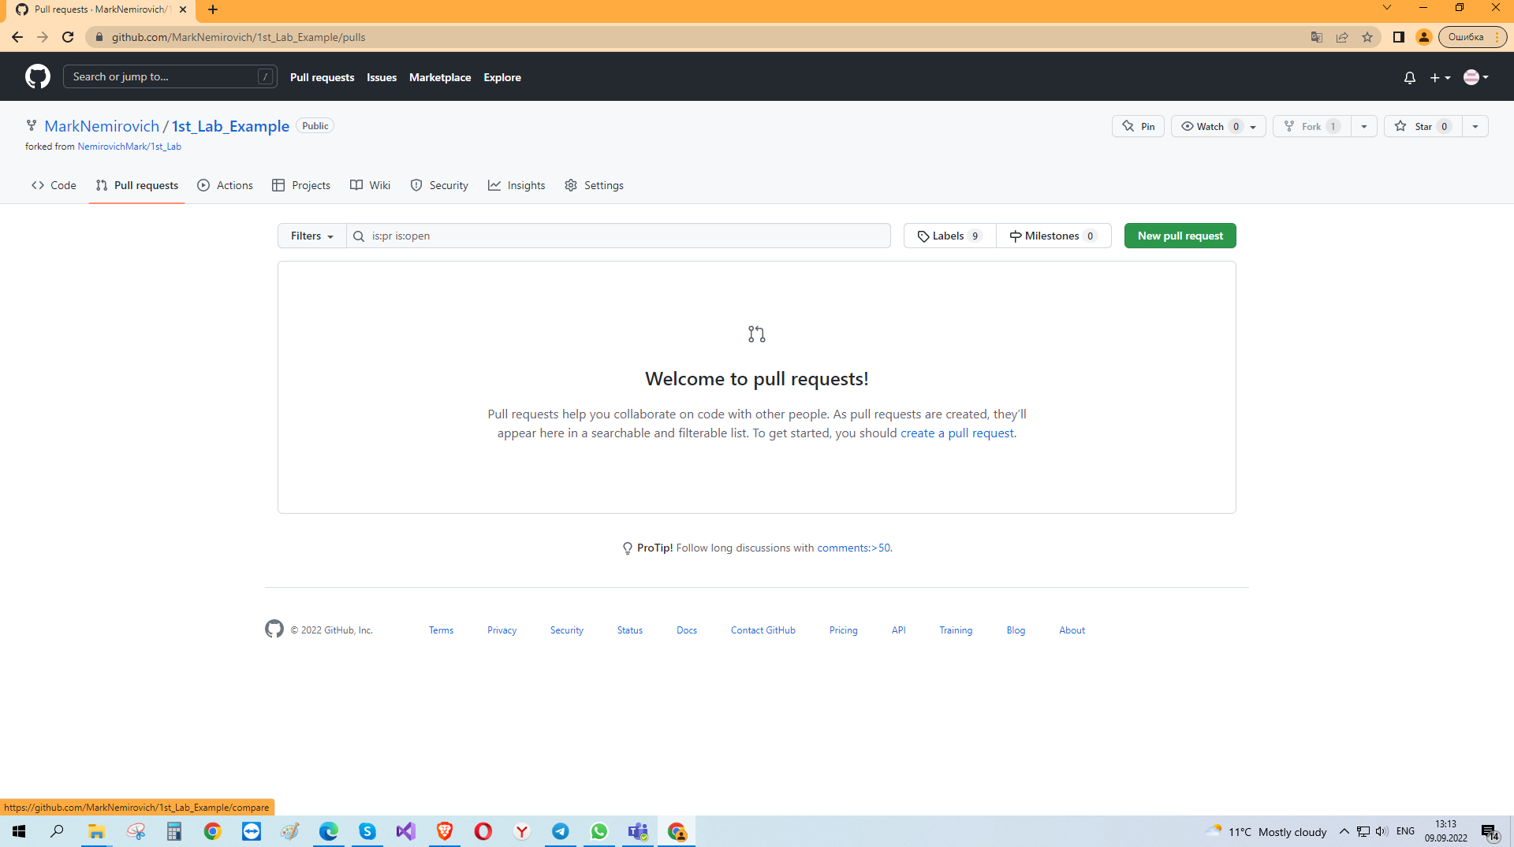
So in your repository go to Pull requests and create new request

Slide 31
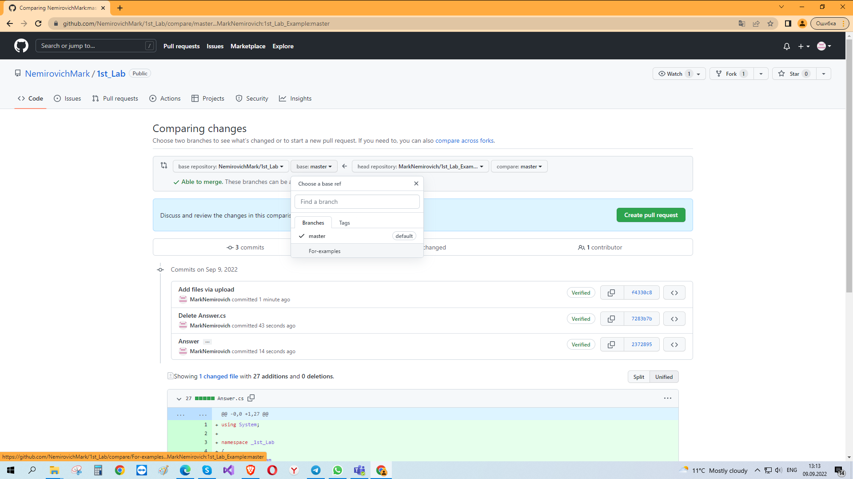
Be careful! Choose your branch in my repository

Slide 32
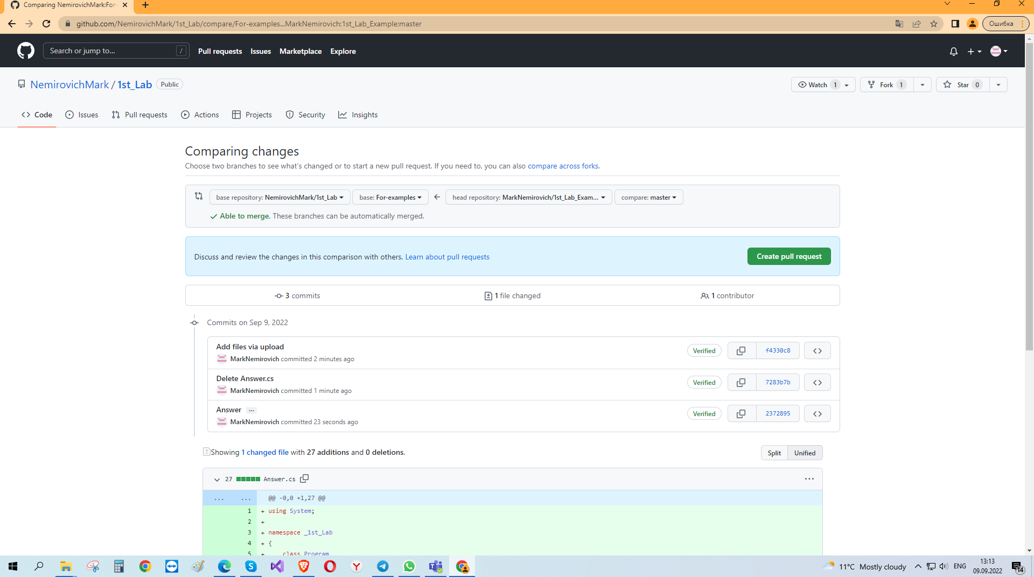
If file types match, create pull request

Slide 33
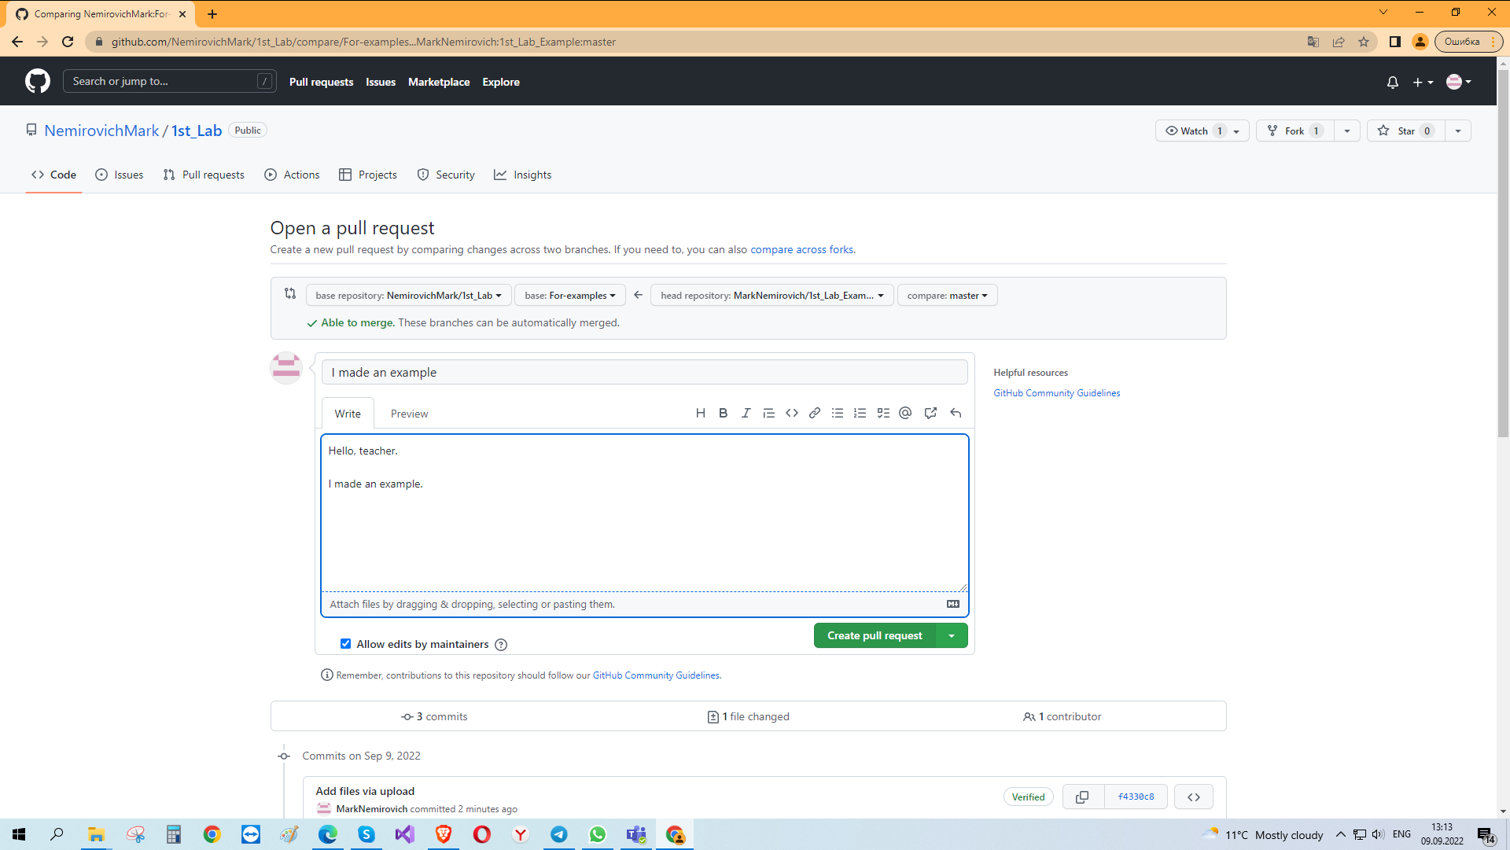
Add comment for me!

Slide 34
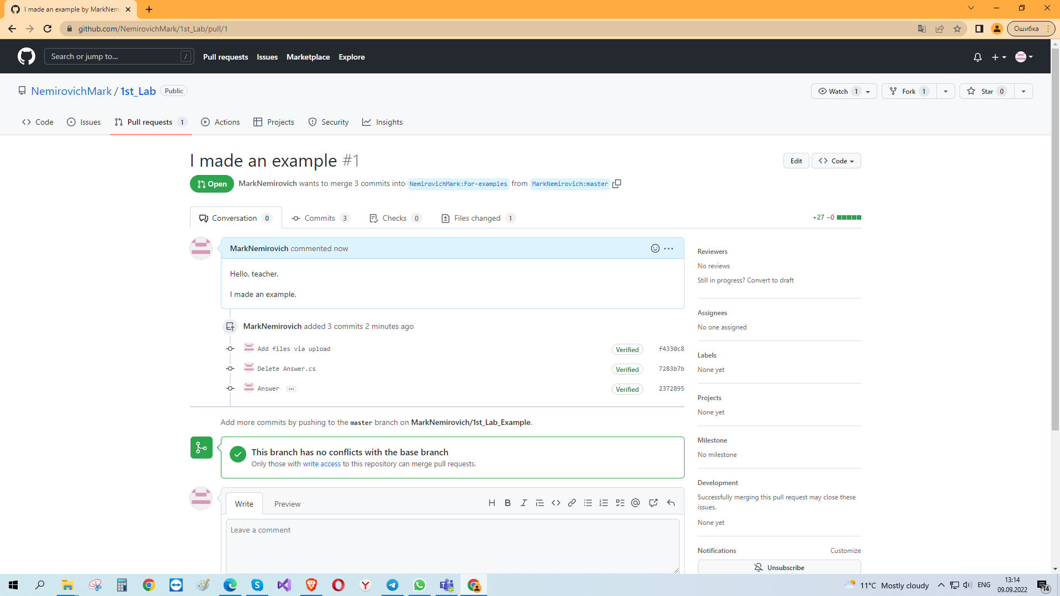
And I will answer you (accept merge or close)

Slide 35
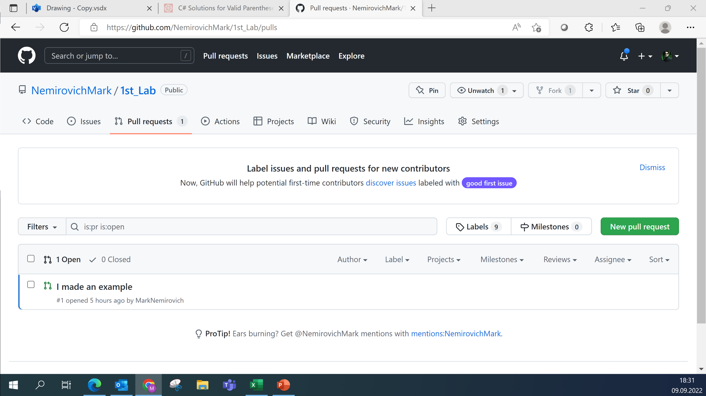
And after that I will review it. It is better to write tasks numbers in the title

Slide 36
Good luck!
and may the Google be with you ☺

